Slide 1
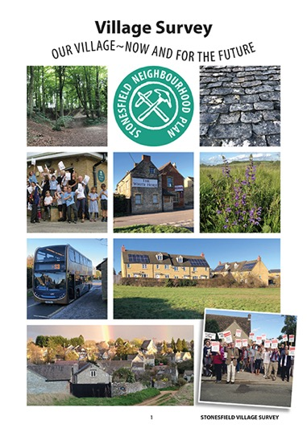

SURVEY RESULTS & UPDATE

Slide 2
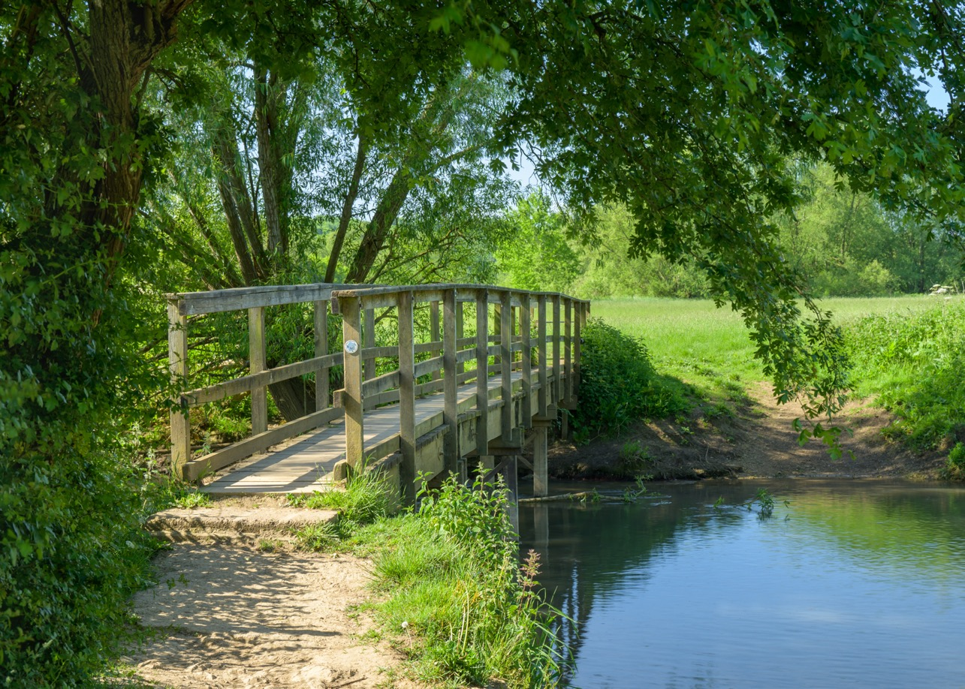
STONESFIELD IS A GREAT PLACE TO LIVE!!
89% of respondents to the Survey said so.

Slide 3
Introductions
Purpose of Meeting
Update on progress of the Neighbourhood Plan
Overview of the Village Survey results
What happens next
Questions & answers

Slide 4
Who is involved?
Stonesfield Parish Council (SPC)
SPC Neighbourhood Plan Steering-Group
Volunteers

Slide 5
What is a Neighbourhood Plan?
Neighbourhood Planning is a way for communities to have a say in the future of where they live and work. It gives you the power to produce a plan with real legal weight that directs development in your local area.
It helps you:
Say what type of new development might be appropriate
Say what those buildings should look like
Say which areas should be designated ‘green spaces’ in order to protect them

Slide 6
Comments people made …
Housing development in a balanced but realistic way
Better bus reliability
Dedicated cycle paths
Enforcing dark skies
Homes for people who most need it
Better infrastructure before building
Community owned renewable energy
The pub
Higher quality homes, more contemporary design
Control creeping development
Clean up the river
Bus to Witney
Homes that are really affordable

Slide 7
Policies vs Aspirations

Slide 8
What have we done so far?
Together with the PC secured a grant to support the work
Village engagement
Village Survey designed, distributed and being collated
Character Assessment of village by volunteers is underway
Landscape Assessment commissioned with external contractor
Keeping tabs on external issues which could impact eg
  - Government policies
  - WODC local plan refresh

Slide 9


The survey results
451 Household responses
out of 727 in Stonesfield
62%
612 Individual responses
out of 1,343 in Stonesfield
45%

Slide 10
Age of respondents
Reflects the demography of the village

Slide 11
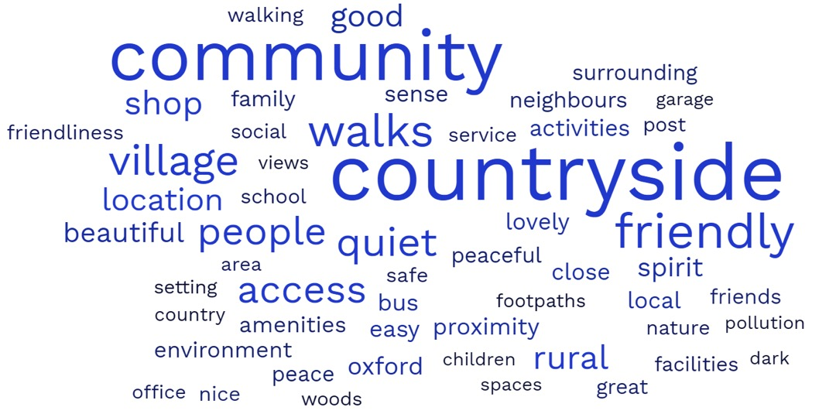
Which three things do you most like about living in Stonesfield?

Slide 12
If there are three things in Stonesfield you would like to see improved, what are they?
responses
Reopen the White Horse pub | 350
Improve bus services | 165
Improve road conditions/pot holes! | 81
River Evenlode/sewerage/water | 74
Improve/restrict parking | 47
Improve pavements & paths | 45

Slide 13
Your top reasons for living in Stonesfield
People living in Stonesfield less than 5 years
Why did you move here?
  63% Countryside
  41% Rural area
  24% House prices
  23% Near employment
People living in Stonesfield more than 5 years
Why have you stayed here?
  81% Countryside
  61% Rural area
  34% Grew up here

Slide 14
What’s important to you?
 | V. important/ important
Protecting green spaces, footpaths & views | 99%
Protecting the Parish’s traditional buildings and other heritage assets | 98%
Protecting trees, woodland, hedges, countryside, wildlife & biodiversity | 98%
Reducing / slowing traffic through the village | 98%
Prevention of sewage overflows in the village | 93%
Addressing pollution of River Evenlode | 72%

Slide 15
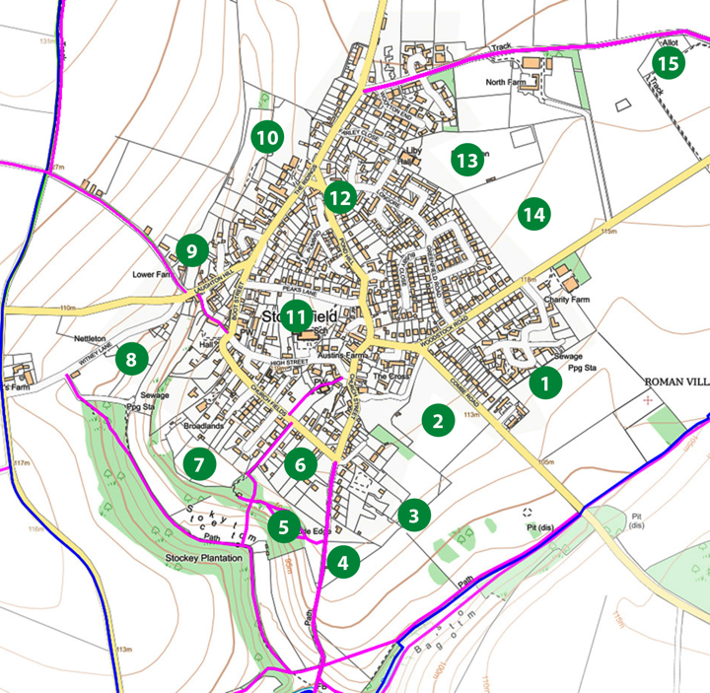
Green spaces
Over 75% of respondents agreed all of these green spaces should be protected

Slide 16
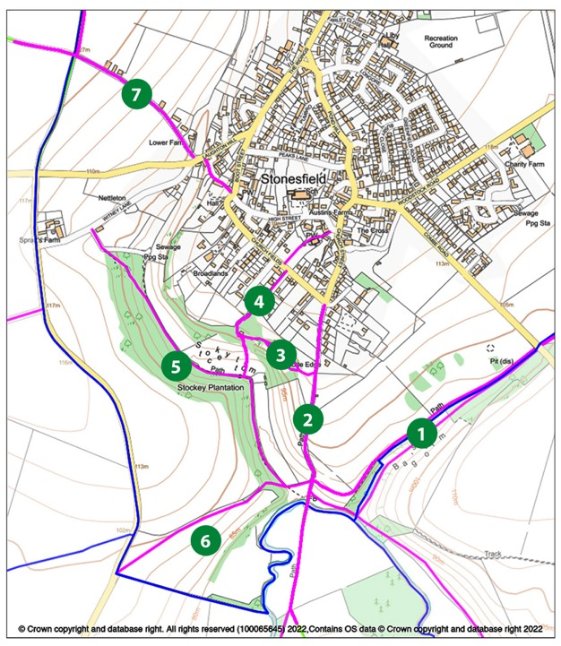
How often do you walk these footpaths?
588 people responded. An average of 362 people walked these paths either daily, weekly or monthly – that’s 62%.
40% walked the paths further away from the village.

Slide 17
Your views on house development
Development within the gardens
of existing residential properties.
Proposals to convert existing domestic dwellings in to smaller units.
Infill housing on any avaiable plot
within the current built up area.
Development of affordable or low-cost houses for people with a Stonesfield or very local employment connections.
20% 40% 60% 80%
Strongly or slightly agree Neutral Strongly or slightly disagree

Slide 18
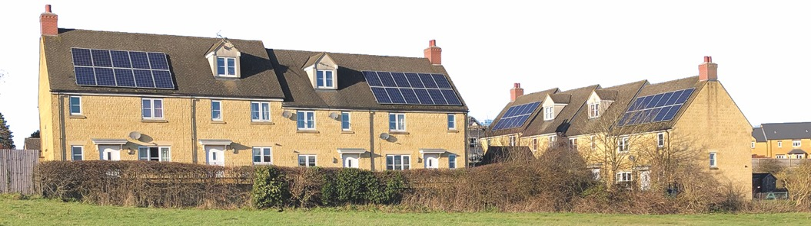
Household tenures
 |  | households
Own outright | 59% | 263
Own with mortgage or loan | 29% | 131
Rent | 10% | 45
5% households are listed on WODC or other Housing Register

Slide 19
Are you planning to move house in the next 5 years?
Yes, in Stonesfield | 29
Not intending to move | 304
Don't know | 74
Why do you want to move in Stonesfield?
Need smaller home / downsizing | 11
Need a bigger home | 17
In the last 5 years, 102 houses have sold in Stonesfield (Rightmove)

Slide 20
Barriers to moving house in Stonesfield
What is preventing you from moving home within Stonesfield? | responses
Affordability/house prices | 23
Lack of suitable type or size of house to buy, or suitable housing to meet my needs | 27

Slide 21
Employment status of responders
 |  | people
In full-time employment | 30% | 180
In part-time employment | 13% | 78
Self-employed | 12% | 69
Retired | 40% | 239

Slide 22
Where do you work?
% of responses
In Stonesfield, from home | 30%
Elsewhere in Oxfordshire | 15%
In Oxford | 11%
In Stonesfield, not from home | 10%
Out of Oxfordshire | 9%
Woodstock | 7%
Witney | 6%

Slide 23
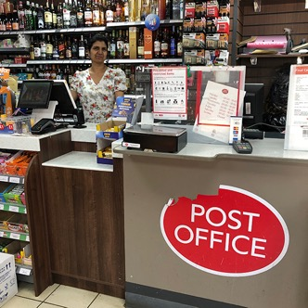
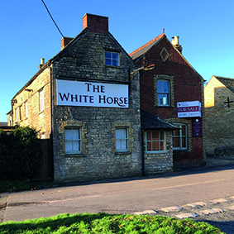
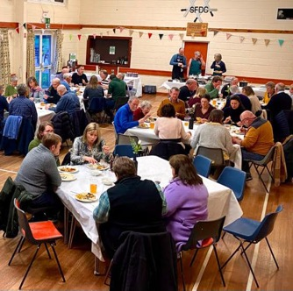
Top amenities – very important or important
Village shop 97%
Post Office 97%
Village pub 86%
Village hall 82%

Slide 24

Where do you shop?
Weekly shopping
Top up shopping
Witney | 277 | 49%
Online | 133 | 23%
Chipping Norton | 62 | 11%
Kidlington | 41 | 7%
Stonesfield | 220 | 39%
Woodstock | 101 | 18%
Long Hanborough | 66 | 12%
Charlbury | 55 | 10%
Witney | 50 | 9%

Slide 25
Transport
What means of transport do you most often use to travel to these villages and towns, excluding for work?
 | Private car | Public bus | Cycle | Walk
Stonesfield | 165 | 7 | 9 | 355
Charlbury | 426 | 23 | 18 | 8
L. Hanborough | 391 | 3 | 5 | 2
Witney | 537 | 22 | 2 | 0
Chipping Norton | 385 | 17 | 2 | 0
Oxford | 310 | 201 | 0 | 0
Woodstock | 448 | 79 | 5 | 2
Kidlington | 372 | 14 | 3 | 0
Banbury | 324 | 4 | 0 | 0
Bicester | 304 | 5 | 0 | 1
Majority walk to amenities in the village
Bus to Oxford and Woodstock
Heavy reliance on car travel

Slide 26
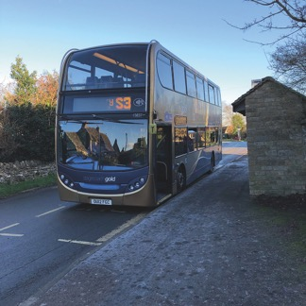
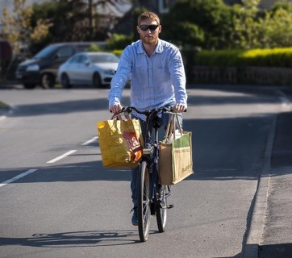

Are there forms of sustainable transport that you would like to use more often?
Over 350 said
BUS
200 said
CYCLING
Over 150 said
WALKING

Slide 27
What Happens Next?
Analyse the survey responses
Housing needs assessment
Create policies using the responses, Landscape and Character Assessments
Write the Plan
Feedback from SPC and WODC
Submission for Planning Examination
Village Referendum YES/NO
2023
2024 …

Slide 28
Q&A

